Slide 1
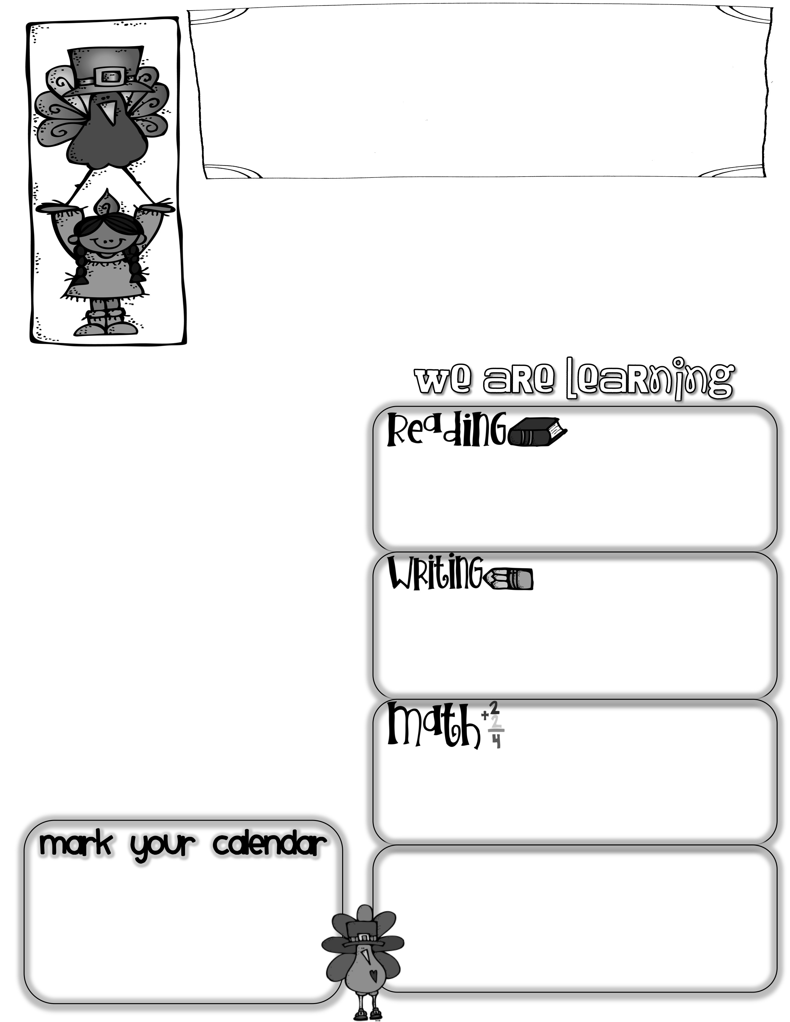
First Grade News
Mrs. Neilander
November 2, 2019
Thank you for your help with the Halloween party! As you can tell from our list of dates at the bottom of this note, November is a crazy month. We will not have a Big Cheese on weeks that are shorter than five days. Additionally, we won’t send home the class mascot, Ted, on weekends that are longer than two days. I will let you know when we will have spelling words to study, but it won’t be every week. October journals are in peechees today. Be sure to have your child read his/hers with you and celebrate their writing successes.
Author of the Week
Lucille Colandro
The Big Cheese
With the end of our first trimester approaching quickly, we are doing reading assessments with each child individually. During the assessment, children are asked to read a short book out loud as the teacher records any mistakes. If they fix a mistake on their own, it does not count against them. We are looking for a level where students can read 90-95% of the words correctly and retell the story afterwards. Any practice at home will be great!
Truman was our Big Cheese this week. Truman has two older brothers that keep him smiling and laughing. His favorite subjects are Reading, Science, and Art. He loves sports including soccer and football. He is a Seahawks fan and even wants to be a Seahawk some day. Maybe he will wave to us all on tv someday as we cheer him on!
This week we wrote riddles describing Halloween costumes. We wrote topic sentences and at least three detail sentences using some descriptive adjectives (spicy words).
Questions to ask your child:
*What do spicy words describe? (the way something looks, feels, sounds, tastes, or smells)
*What is the opposite of addition?
Wapaishone Day
Members from the local Wapaishone tribe will be visiting and teaching schoolwide lessons next Thursday, November 7th. The events last most of the day and students learn about the culture and traditions of the tribe.
We are working hard in Math
to finish up our first huge unit. We will take a test on that unit sometime next week. The test will review addition and subtraction, as well as solving word problems using both operations.
*There is no school on the following days:
Nov. 8th (Teacher Work Day),
Nov. 11th (Veteran’s Day),
Nov. 18th (Parent-Teacher Conferences), and Nov. 27th-29th (Thanksgiving) .
Wednesday, Nov. 13th is a Late Start beginning at 10:20.
Math questions to ask your child:
*How can you use addition to check your subtraction work?
* What do we look for when checking math
journals? (neat, precise models, equations and number bonds that match the problem, accurate solutions that answer the question)

