Slide 1
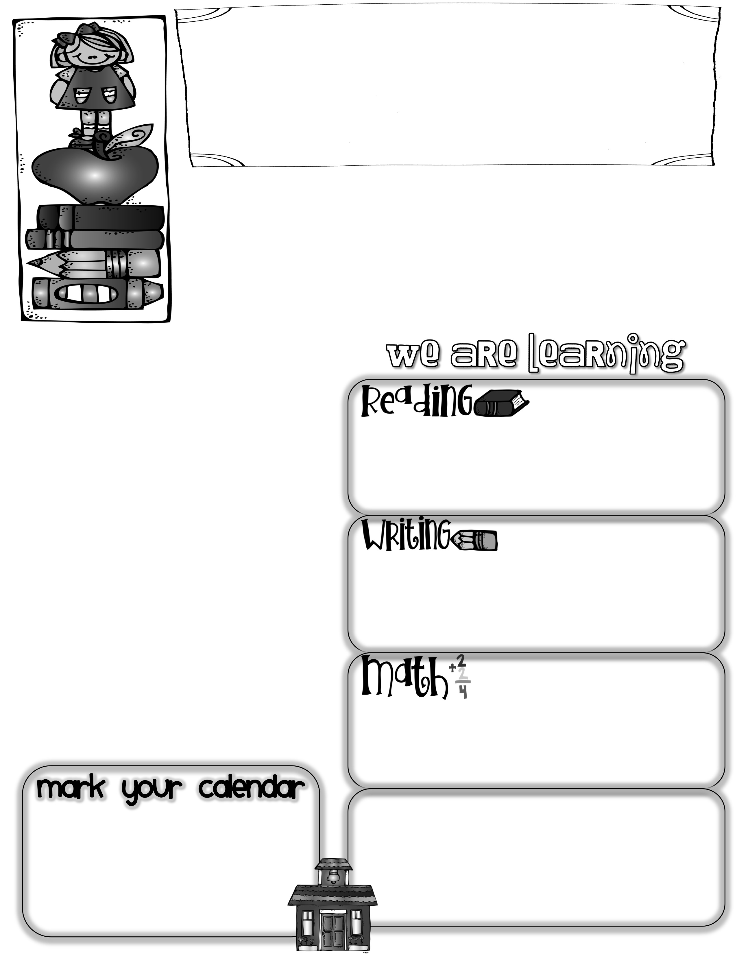
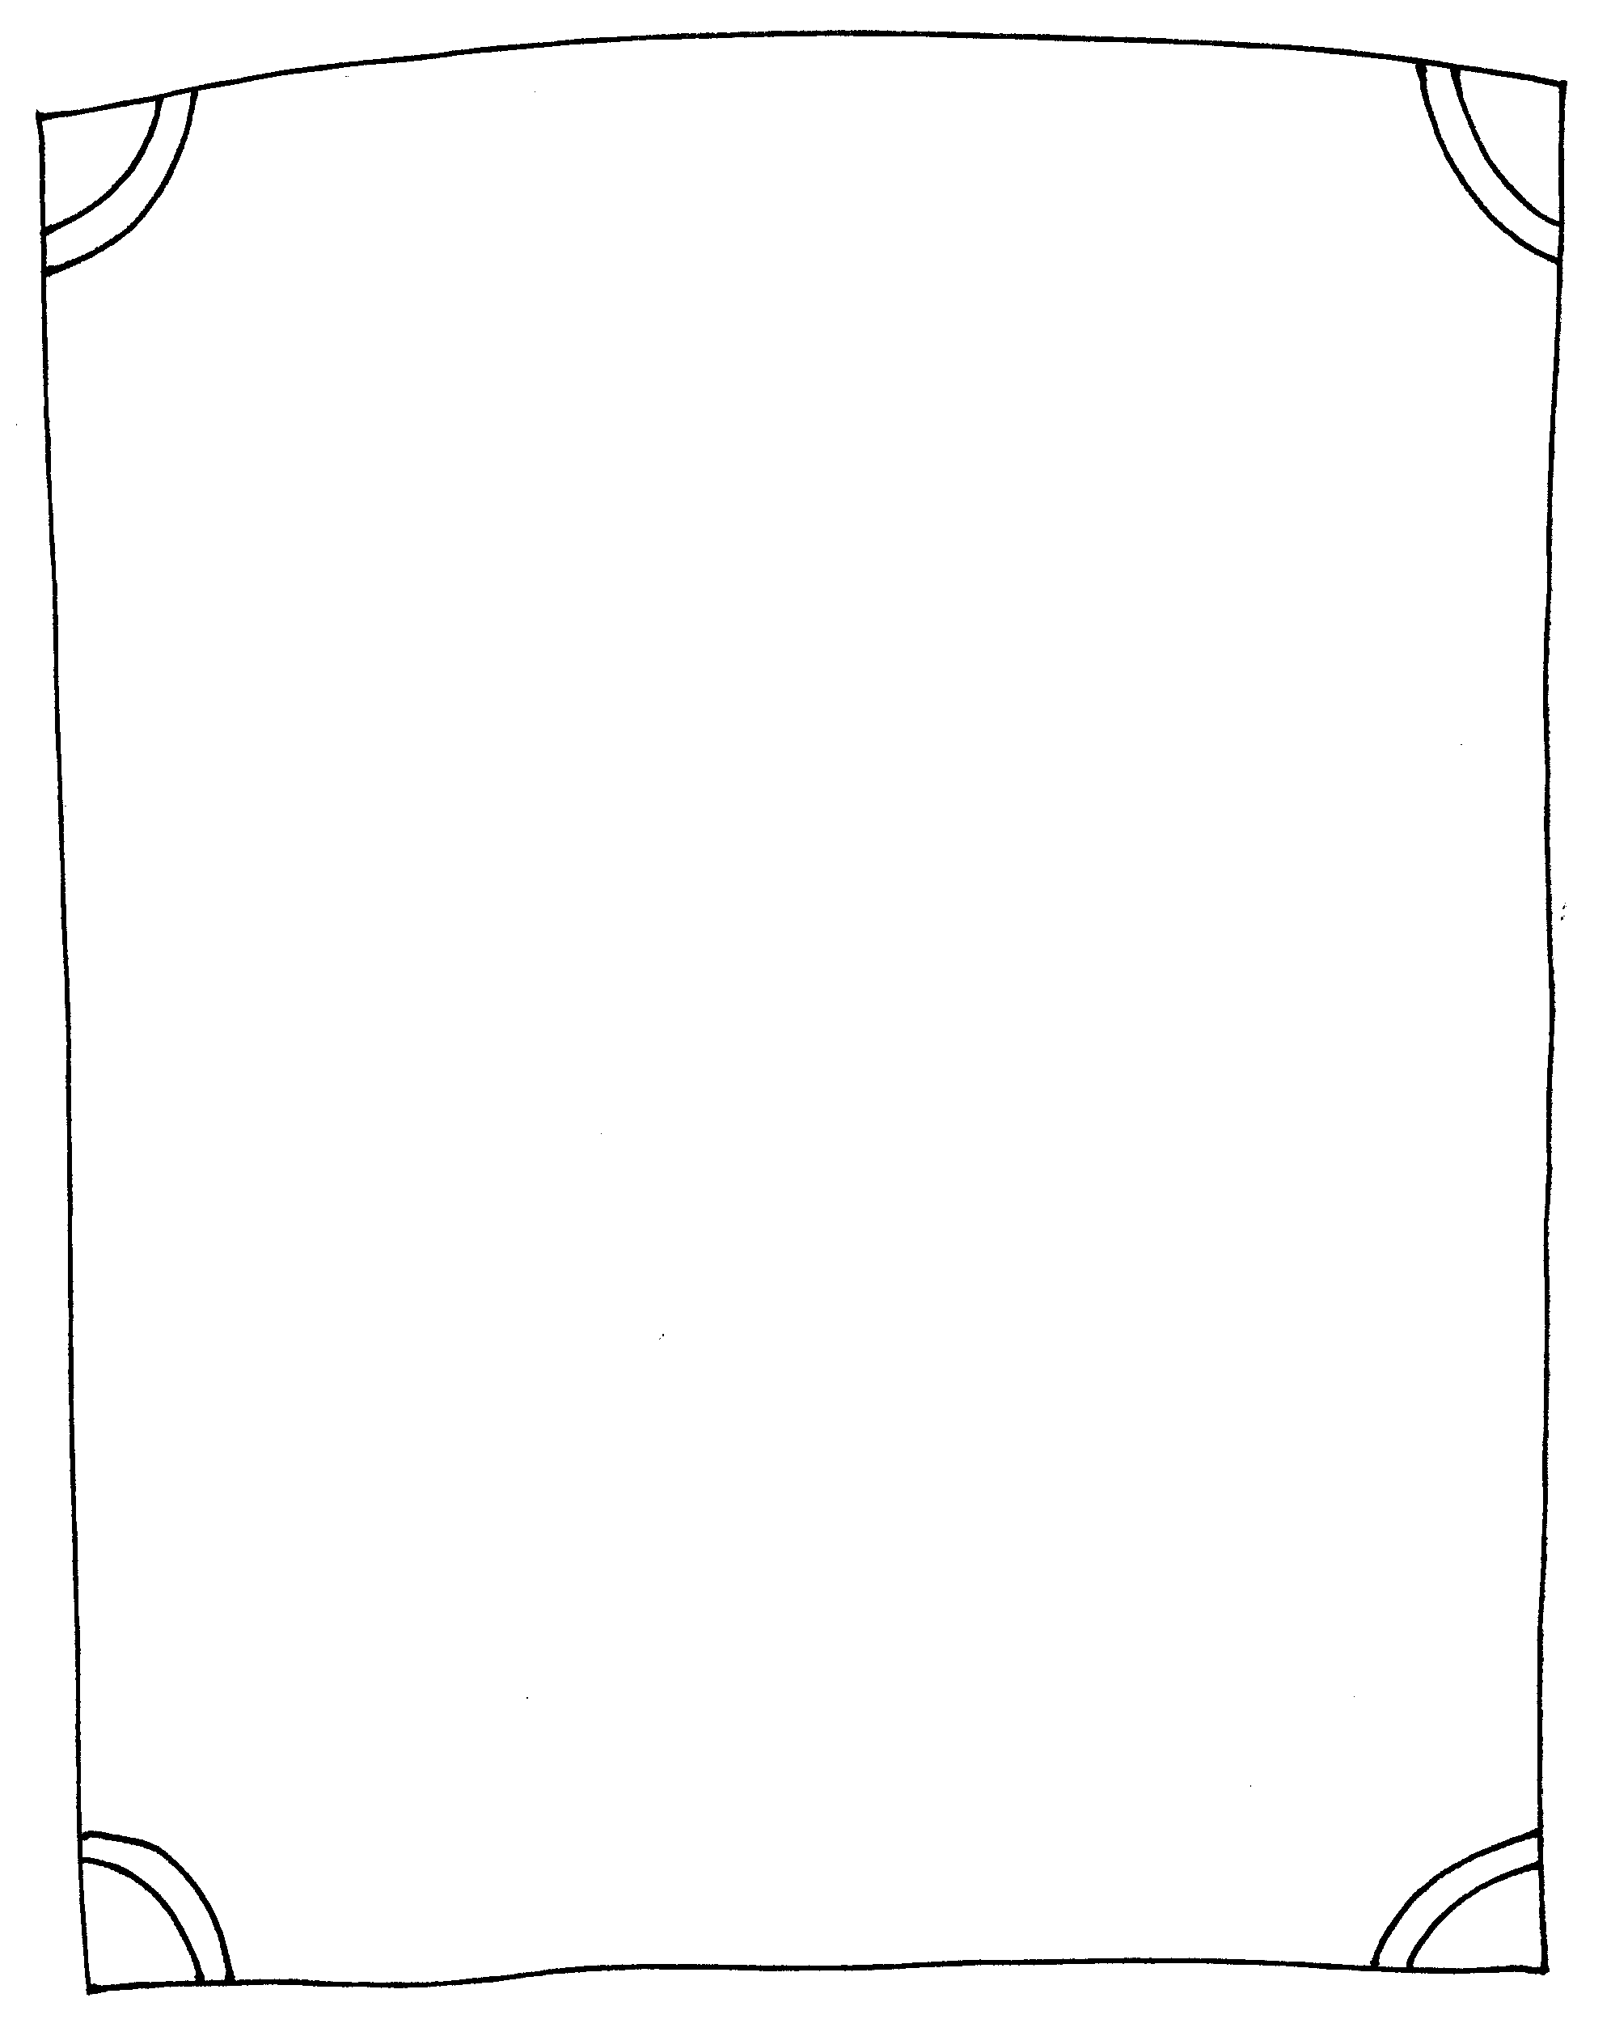
First Grade News
Mrs. Neilander
August 23, 2019
We just finished a successful second week of 1st Grade! Thank you to those that were able to attend our Back-To-School Night presentation. I hope it was helpful for you. If you have not already returned the Information Sheet, please do so as soon as possible, and I promise this is the last form for a while! I am sending home the information that we covered in today’s peechee for those of you who were unable to attend.
Thank you!
Author of the Week:
Next week we will begin to study and read books written by Kevin Henkes.
Other Important Information:
We have been studying the Pledge of Allegiance and have just completed our book about it. Be sure to have your child read their book to you and explain what each page means. This would be a great thing to save and put in our upcoming Treasure Boxes.
*I put a weekly behavior score on peechees each week. It is a scale of 1-5, with 1 being the best. This score should correlate with the behavior chart I send home each Friday.
*If you change the way your child is to get home during the day, please do not inform me in an e-mail that afternoon. I often don’t have time to read them till after school. Instead, call the office.
In writing this week we worked on writing informative pieces about our flag. We began with taking notes, then making circle maps, moved to tree maps, then on to 3 complete sentences. Next, we worked on editing our final pieces with a partner looking for capitals, periods, and finger spacing.
Questions to ask your child:
*Why are there 50 stars and 13 stripes on our American flag?
*What was your favorite part of 1st Grade this week?
*What are some of the signals and cheers we have been using in 1st Grade?
Please look for the math newsletter in today’s peechee explaining our unit of study. In addition to this information, we have begun using our math journals. In them, students are drawing a picture, writing an equation, writing their solutions, and discussing their results.
*Treasure boxes are due on Friday, September 4th .
*Regular homework packets will begin on Friday the 13th of September. (As creepy as that sounds….)
Math Questions to ask your child:
*Can you tell me what the M.E.S. model stands for when your solving a math problem?
(Model, Equation, Solution)
*What happens to your brain when you find and fix mistakes that you made?

