Slide 1
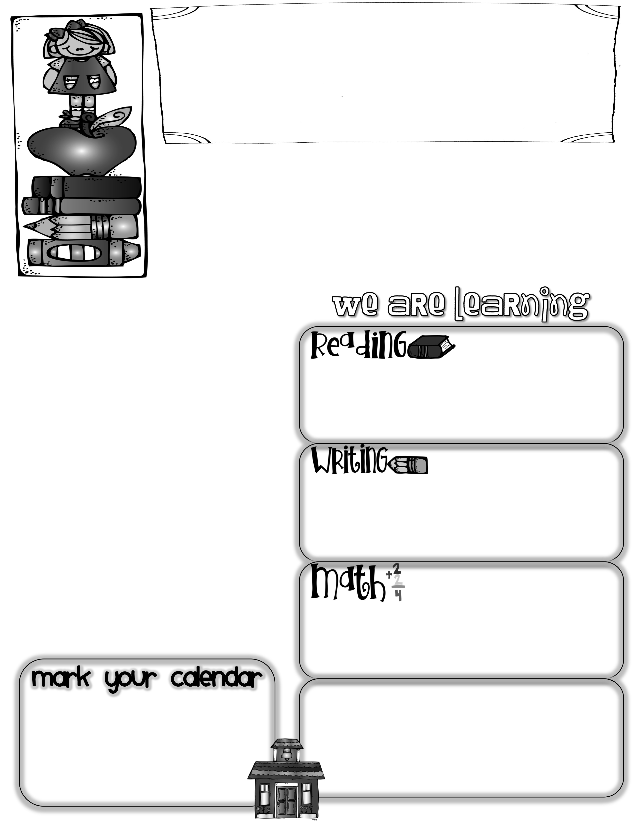
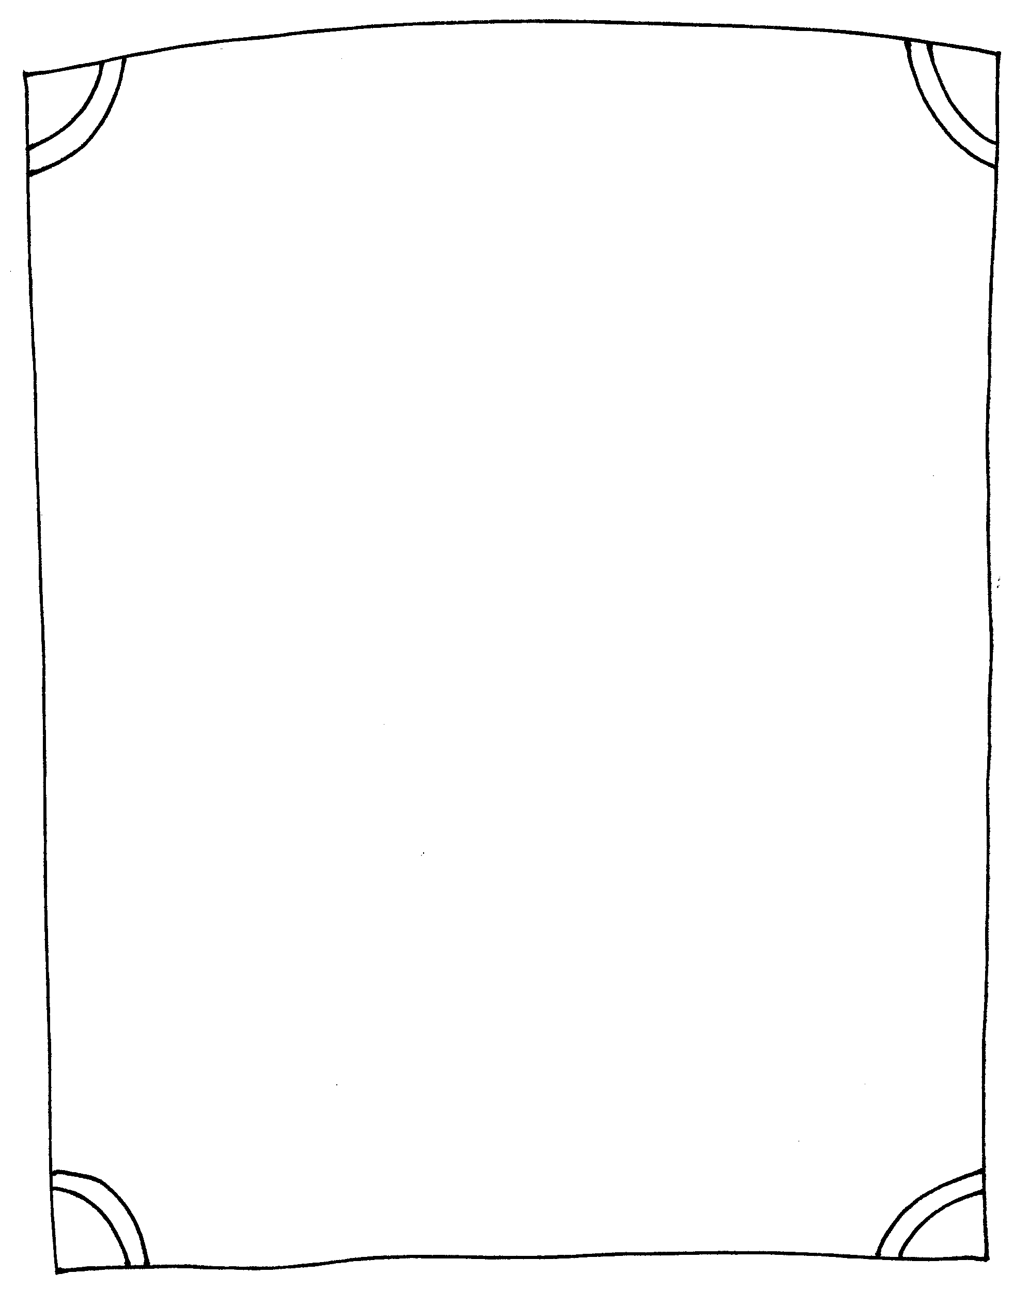
First Grade News
Mrs. Neilander
August 31, 2018
Next week we will be learning about the sun and how it affects the seasons. We will also experiment with shadows and sunlight.
Headphones
If possible, please send a set of headphones or earbuds for just your child to use with our Chrome Books. Please put them in a baggie with your child’s name on it. I have some for kids to borrow if you are unable to provide some.
I hope you have a wonderful long weekend with your children!
Author of the Week
Kevin Henkes
The Big Cheese
Sophia was our Big Cheese this week. She has one sister. In school, Sophia likes math and science. She says she is good at bossing people, and her favorite sport is baseball. When she grows up, Sophia wants to be a dancer. One thing is for sure…she has danced her way into our hearts!
During our reading block of time, we practiced reading books alone, with a partners, and in small groups this week. We also learned about selecting books that are at a “just right” reading level and getting the most out of them. (See the note on the back of this letter.)
This week we wrote about our class. We began with circle maps, made those into tree maps, and then wrote 3 complete sentences. We also edited the sentences for capitals and periods.
Questions to ask your child:
*How do you know if a book is too hard? Too easy? Just right?
*What is the name of our new month?
*What are the four seasons? Which season are we in right now?
Math this week focused on different combinations of numbers used to make numbers through ten. We have also been solving problems in our math journals.
*No school Monday, September 3rd for Labor Day.
*Treasure Boxes are due on Friday, September 7th.
*Regular homework will begin on Friday, September 14th.
*Wednesday, September 12th is a Late
Start Day.-- Classes begin at 10:20..
Math Questions to ask your child:
How many combinations can you think of to make the number 7? 8? 9? 10?
*What is an equation?
What is a “brother problem”? 2+4=6, 4+2=6

