Slide 1
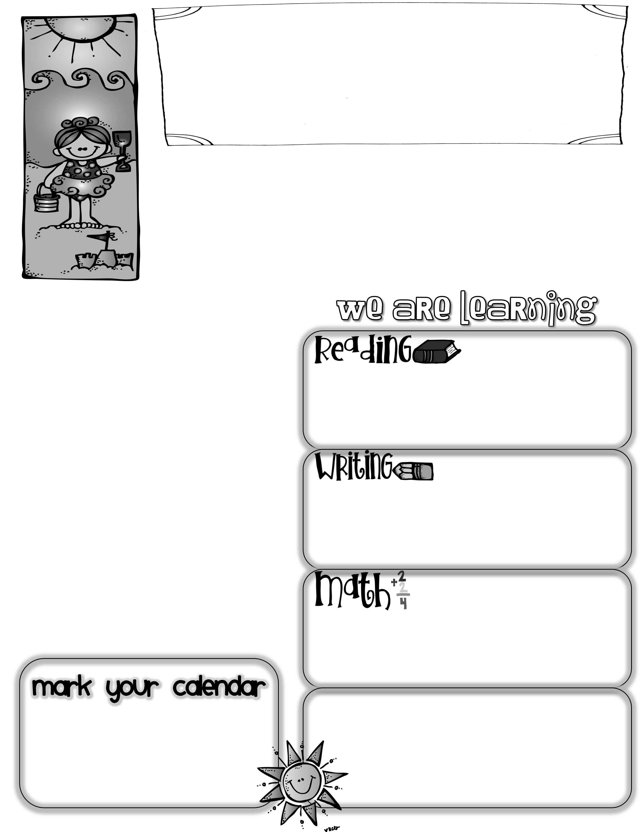
First Grade News
Mrs. Neilander
August 16, 2019
We all survived the first week of First Grade! Thank you for sharing your children with me….what a great group of students! Please look for this newsletter in Friday peechee folders each week. In it, I will recap the events from the past week and tell what the next week of school will hold. Please read through the contents of the folder, sign or initial it beside the date, and return it empty each Monday. Also, please read and sign the inside of the peechee folder showing that you have read the MES expectations and rules. I will explain the number scoring of behavior in peechees during the
Back-To-School Night presentation on August 22nd.
If you pick up your child after school, we will normally come out of the doors at the end of our B Hallway. Once in a while, on bad weather days, we will come out the gym doors. Please make sure your child lets me know they are leaving with you before they take off.
Homework
We are working on assessing the students’ basic reading levels and learning routines this month so that we may begin our leveled reading soon.
Our first homework will be to decorate a Treasure Box to hold all of our 1st Grade Treasures. I will explain the directions at Back-To-School Night. Our regular homework will begin after that.
We began our journal writing this week. Writing journals come home at the end of each month.
Back-To-School Night
I do have lots of information to share with you next week. In order to cover all the information in our short half hour, I would ask that you not bring your children if possible. Of course, if bringing them is the only way you can attend, they are welcome to sit quietly during the presentation. This will be from 5:30-6:00 in our classroom (B-6) on Thursday, August 22nd. Thank you!
This week we explored with the many math manipulatives we will use throughout the year. We also did several activities to help create an open mind set for the math we will do this year.
*Back-To-School Night-Thursday, August 22nd 5:30-6:00-Room B-6
*Labor Day-Monday, September 2nd (no school)
Questions to ask your child:
*What is your favorite thing about 1st Grade so far?
*What are the names of two new friends you have made this week?
*What do 1st Graders do when Mrs. Neilander says “Fiddle-dee-dop-n-doo”?

